Slide 1
Understanding and Diagnosing Out of Memory Errors in Distributed Data-Parallel Applications
Lijie Xu
Institute of Software
Chinese Academy of Sciences
2015-11-05

Slide 2



Background
Data-intensive applications are common
Web indexing
Text processing
Table analysis
Graph analysis
Machine learning
Apps run atop distributed data-parallel frameworks
MapReduce (e.g., Apache Hadoop)
MapReduce-like (e.g., Apache Spark, Microsoft Dryad)

Slide 3







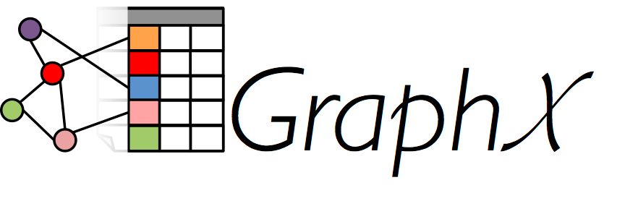
Background – Application development
Application: <input data, configurations, user code>
User Layer
User code
1 public class Mapper {
2 StanfordLemmatizer slem = new StanfordLemmatizer();
3 public void map(Long key, Text value) {
4 String line = value.toString();
5 for(String word: slem.lemmatize(line))
6 emit(word, 1);
7 }
8 }
Raw code
1 pTable = LOAD “tableA” as (pagerank,pageurl,aveduration);
2 rankTable = GROUP pTable BY pagerank;
3 urlTable = FOREACH rankTable {
4 urls = DISTINCT urlTable.pageurl;
5 GENERATE group, COUNT(urls), SUM(pTable.aveduration);
6 };
7 STORE urlTable into "/output/newTable";
SQL-like Pig script

Slide 4
Background – Application execution
MapReduce framework: distributed dataflow
Features: map stage => reduce stage, partition => aggregation
Map stage
Reduce stage
Framework Layer

Slide 5
Background – Application execution
MapReduce framework: distributed dataflow
Features: map stage => reduce stage, partition => aggregation
Partition
Aggregation
Framework Layer

Slide 6
Background – Application execution
MapReduce-like framework: DAG-based stages, pipeline
Map stage
DAG-based stages
Reduce stage
Map stage

Slide 7
Background – Application execution
MapReduce-like framework: DAG-based stages, pipeline
RDD 1
RDD 2
Data model: RDDs
RDD 5
RDD 6
RDD 7
RDD 3
RDD 4

Slide 8
Background – Application execution
MapReduce-like framework: DAG-based stages, pipeline
Pipeline

Slide 9
Background – Application execution
Driver program
Generate and broadcast data to tasks
Collect the tasks’ results

Slide 10
Background – Application execution
Driver program
Generate and broadcast data to tasks
Collect the tasks’ results

Slide 11
Background – Physical memory layer
Each task runs as a
process/thread
Physical
Memory Layer

Slide 12
Motivation – Memory usage problems
High memory consumption is common
High memory consumption
High memory consumption

Slide 13
Motivation – Memory usage problems
High memory consumption is common
High memory consumption
=> OOM errors
FATAL org.apache.hadoop.mapred.Child: Error running child :
java.lang.OutOfMemoryError: Java heap space
at java.util.Arrays.copyOf(Arrays.java:2882)
...
at cloud9.ComputeCooccurrenceMatrixStripes$MyReducer.
reduce(ComputeCooccurrenceMatrixStripes.java:136)
at org.apache.hadoop.mapred.Child.main(Child.java:404)
OOM stack trace
OOM
OOM

Slide 14
Motivation – Memory usage problems
Re-execute the failed task cannot help
Re-execute
OOM
occurs again
OOM

Slide 15

Motivation – Memory problem examples
Some memory issues in StackOverflow.com and Hadoop/Spark mailing list
Why the mapper is consuming so much memory?
I got very surprised to see the job failing in the map phase with “Out of memory error”. What can be the cause of such error?
My question is how to deal with out of memory problem, I added some property configuration into xml file, but it didn’t work. Increasing number of reducers doesn’t work for me either.
Hadoop/Spark mailing list

Slide 16
Outline
1. Empirical study on OOM causes and fixes
2. Design memory profiler for diagnosing memory problems

Slide 17
1. Empirical study on OOM causes and fixes

Slide 18
Research questions
RQ 1
What are the OOM root causes?
RQ 2
Are there any common fix patterns?
RQ 3
Are there any new fault-tolerant mechanisms?
Notes:
常见原因和修复方法，构建内存用量模型并估算应用的内存用量，内存溢出错误的诊断方法

Slide 19



Methodology – Subject collection
Application source
(open-source and widely used)
Bug source
Open forums
No special bug repository for OOM errors
Open forums contain professional discussion
Hadoop/Spark committers, experienced developers, and users

Slide 20
Methodology – Subject collection
a
Google keywords
in open forums
Select memory issues
that are OOM errors
Select OOM errors with identified causes
1,151 memory issues
276 OOM errors
123 OOM errors
Keywords:
“Hadoop out of memory”, “Spark OOM”,
“Spark heap error”
Selection criteria:
The error is an OOM error, and occurs in the apps
Selection criteria:
1. Experts identified the causes
2. Users identified the causes
3. We identified the causes

Slide 21
Methodology – Subjects
Distribution of the studied 123 OOM errors
Causes are identified by experts (66), users (45), us (12)
Framework | Sources | Raw code | Pig | Hive | Mahout | Cloud9 | GraphX | MLlib | Total | Reproduced
Hadoop | StackOverflow.com | 20 | 4 | 2 | 4 | 0 | 0 | 0 | 30 | 16
 | Hadoop mailing list | 5 | 5 | 1 | 0 | 1 | 0 | 0 | 12 | 6
 | Developers’ blogs | 2 | 1 | 0 | 0 | 0 | 0 | 0 | 3 | 2
 | MapReduce books | 8 | 3 | 0 | 0 | 0 | 0 | 0 | 11 | 2
Spark | Spark mailing list | 16 | 0 | 0 | 0 | 0 | 1 | 2 | 19 | 3
 | StackOverflow.com | 42 | 0 | 0 | 0 | 0 | 1 | 5 | 48 | 14
Total |  | 93 | 13 | 3 | 4 | 1 | 2 | 7 | 123 | 43
OOM cases in our technical report. https://github.com/JerryLead/MyPaper/blob/master/OOM-Study.pdf

Slide 22
Methodology – Subjects
Distribution of the studied 123 OOM errors
Contain diverse applications
raw code, high-level languages/libraries
Framework | Sources | Raw code | Pig | Hive | Mahout | Cloud9 | GraphX | MLlib | Total | Reproduced
Hadoop | StackOverflow.com | 20 | 4 | 2 | 4 | 0 | 0 | 0 | 30 | 16
 | Hadoop mailing list | 5 | 5 | 1 | 0 | 1 | 0 | 0 | 12 | 6
 | Developers’ blogs | 2 | 1 | 0 | 0 | 0 | 0 | 0 | 3 | 2
 | MapReduce books | 8 | 3 | 0 | 0 | 0 | 0 | 0 | 11 | 2
Spark | Spark mailing list | 16 | 0 | 0 | 0 | 0 | 1 | 2 | 19 | 3
 | StackOverflow.com | 42 | 0 | 0 | 0 | 0 | 1 | 5 | 48 | 14
Total |  | 93 | 13 | 3 | 4 | 1 | 2 | 7 | 123 | 43

Slide 23
Methodology – Subjects
Distribution of the studied 123 OOM errors
Contain diverse applications
raw code, high-level languages/libraries
Framework | Sources | Raw code | Pig | Hive | Mahout | Cloud9 | GraphX | MLlib | Total | Reproduced
Hadoop | StackOverflow.com | 20 | 4 | 2 | 4 | 0 | 0 | 0 | 30 | 16
 | Hadoop mailing list | 5 | 5 | 1 | 0 | 1 | 0 | 0 | 12 | 6
 | Developers’ blogs | 2 | 1 | 0 | 0 | 0 | 0 | 0 | 3 | 2
 | MapReduce books | 8 | 3 | 0 | 0 | 0 | 0 | 0 | 11 | 2
Spark | Spark mailing list | 16 | 0 | 0 | 0 | 0 | 1 | 2 | 19 | 3
 | StackOverflow.com | 42 | 0 | 0 | 0 | 0 | 1 | 5 | 48 | 14
Total |  | 93 | 13 | 3 | 4 | 1 | 2 | 7 | 123 | 43

Slide 24
Methodology – Subjects
Distribution of the studied 123 OOM errors
42 cases have fix methods
Framework | Sources | Raw code | Pig | Hive | Mahout | Cloud9 | GraphX | MLlib | Total | Reproduced
Hadoop | StackOverflow.com | 20 | 4 | 2 | 4 | 0 | 0 | 0 | 30 | 16
 | Hadoop mailing list | 5 | 5 | 1 | 0 | 1 | 0 | 0 | 12 | 6
 | Developers’ blogs | 2 | 1 | 0 | 0 | 0 | 0 | 0 | 3 | 2
 | MapReduce books | 8 | 3 | 0 | 0 | 0 | 0 | 0 | 11 | 2
Spark | Spark mailing list | 16 | 0 | 0 | 0 | 0 | 1 | 2 | 19 | 3
 | StackOverflow.com | 42 | 0 | 0 | 0 | 0 | 1 | 5 | 48 | 14
Total |  | 93 | 13 | 3 | 4 | 1 | 2 | 7 | 123 | 43

Slide 25
RQ1: OOM cause patterns
Category | Cause patterns | Hadoop | Spark | Total | Ratio
Large data stored in the framework | Large data buffered by the framework | 6 | 2 | 8 | 6%
 | Large data cached by users for reuse | 0 | 7 | 7 | 6%
Abnormal dataflow | Improper data partition | 3 | 13 | 16 | 13%
 | Hot key | 15 | 8 | 23 | 18%
 | Large single key/value record | 6 | 1 | 7 | 6%
Memory-consuming user code | Large external data loaded in user code | 8 | 0 | 8 | 6%
 | Large intermediate results | 4(3) | 2 | 6(3) | 5%
 | Large accumulated results | 30[13] | 10[1] | 40[14] | 33%
 | Large data generated in the driver | 0 | 9 | 9 | 7%
 | Large results collected by the driver | 0 | 16 | 16 | 13%
Total |  | 72 | 68 | 123+17 | 113%

Slide 26
RQ1: OOM cause patterns
Category: Large data stored in the framework (12%)
Pattern 1: Large data buffered by the framework (8 errors, 6%)
Large map buffer (500MB), large shuffle buffer (70%)
Pattern 1: Large data buffered by the framework (8 errors, 6%)
Large map buffer
Large shuffle buffer

Slide 27
RQ1: OOM cause patterns
Category: Large data stored in the framework (12%)
Pattern 1: Large data buffered by the framework (8 errors, 6%)
Why does the large buffer lead to the OOM error?
Pattern 1: Large data buffered by the framework (8 errors, 6%)
Large map buffer or shuffled partition
e.g., 500MB Byte[]
OOM

Slide 28
RQ1: OOM cause patterns
Category: Large data stored in the framework (12%)
Pattern 2: Large data cached in the framework (7 errors, 6%)
Users explicitly cache large data for reuse (e.g., for next job)
Pattern 2: Large data cached in the framework (7 errors, 6%)
First job
Second job
OOM
Large data cached for reuse

Slide 29
RQ1: OOM cause patterns
Category: Abnormal dataflow (large runtime data, 37%)
用户配置的 partition number 过小，partition functio
Small partition number, unbalanced partition function
Pattern 1: Improper data partition (16 errors, 13%)
Each partition is large
OOM

Slide 30
RQ1: OOM cause patterns
Category: Abnormal dataflow (large runtime data, 37%)
用户配置的 partition number 过小，partition functio
Small partition number, unbalanced partition function
Pattern 1: Improper data partition (16 errors, 13%)
Unbalanced partitions
OOM

Slide 31
RQ1: OOM cause patterns
Category: Abnormal dataflow (large runtime data, 37%)
Pattern 2: Hotspot key (23 errors, 18%)
Case: Frequent words (e.g., “the”) occur in much more pages
Pattern 2: Hot key (23 errors, 18%)
OOM
while aggregating or processing large <k, list(v)>
<k4, list(v)> is much larger than <k1, list(v)>

Slide 32
RQ1: OOM cause patterns
Category: Abnormal dataflow (large runtime data, 37%)
Pattern 3: Large single key/value record (7 errors, 6%)
Case: a 350MB line full of character a, with wrong terminal tokens
Pattern 3: Large single key/value record (7 errors, 6%)
OOM
while user code is processing large <k4, v2>
<k4, v2> is much larger than <k4, v1>

Slide 33
RQ1: OOM cause patterns
Category: Abnormal dataflow (large runtime data, 37%)
Pattern 2: Hotspot key (23 errors, 18%)
Why aggregating large records can lead to OOM errors?
Spark uses HashMap-like data structure (ExternalAppendOnlyHashMap) to aggregate the shuffled <k, v> records
ExternalAppendOnlyHashMap

Slide 34
RQ1: OOM cause patterns
Category: Abnormal dataflow (large runtime data)
Why aggregating large records can lead to OOM errors?
Large data partition =>
too many <k, v>s
Hot key =>
large <k, list(v)>
This map does not estimate the size of each object added to the map.
[SPARK-1823] ExternalAppendOnlyMap can still OOM if one key is very large.
Large single <k, v> record

Slide 35
RQ1: OOM cause patterns
Category: Memory-consuming user code (64%)
Pattern 1: Improper data partition (16 errors, 13%)
User code loads large data before processing the records
Pattern 1: Large external data loaded in user code (8 errors, 6%)
public class Mapper {
private Object buffer;
public void setup() { buffer.load(trainingData1GB);}
public void map(K key, V value) {
Object iResults1GB = process(key, value);
buffer.add(iResults1GB); //Optional
emit(newKey, newValue);
}
}
Loading large external data

Slide 36
RQ1: OOM cause patterns
Category: Memory-consuming user code (64%)
Pattern 2: Hotspot key (23 errors, 18%)
While user code is processing a single <k, v> record
Cases: large input record, Cartesian product of two sets > one set
Pattern 2: Large intermediate results (6 errors, 5%)
public class Mapper {
private Object buffer;
public void setup() { buffer.load(trainingData1GB);}
public void map(K key, V value) {
Object iResults1GB = process(key, value);
buffer.add(iResults1GB); //Optional
emit(newKey, newValue);
}
}
Generating large intermediate results
Pattern 2

Slide 37
RQ1: OOM cause patterns
Category: Memory-consuming user code (64%)
Pattern 3: Large single key/value record (7 errors, 6%)
Accumulating large intermediate computing results
Cases: computing the mean and variance, building inverted index
Pattern 3: Large accumulated results (40 errors, 33%)
public class Mapper {
private Object buffer;
public void setup() { buffer.load(trainingData1GB);}
public void map(K key, V value) {
Object iResults1MB = process(key, value);
buffer.add(iResults1MB);
emit(newKey, newValue);
}
}
Thousands of <k, v> records =>
Large accumulated results
Pattern 3

Slide 38
RQ1: OOM cause patterns
Category: Memory-consuming user code (64%)
Pattern 3: Large single key/value record (7 errors, 6%)
Accumulating large intermediate computing results
Pattern 3: Large accumulated results (40 errors, 33%)
public class Reducer {
private Object reduceBuffer;
public void reduce(K key, List<V> values) {
Object groupBuffer;
while(values.hasNext()) {
V value = values.next();
Object iResults1MB = process(key, value);
group/reducebuffer.add(iResults1MB);
emit(newKey, newValue);
}
}
}
Pattern 3

Slide 39
RQ1: OOM cause patterns
Category: Memory-consuming user code (64%)
Pattern 3: Large single key/value record (7 errors, 6%)
Example: JOIN(TableA, TableB) => buffered (id1, rowA) JOIN (id1, rowB)
Pattern 3: Large accumulated results (40 errors, 33%)
Table A
Table B
reduce(k, list(v))
ID | A
1 | a
3 | b
3 | c
3 | d
3 | e
3 | a
5 | b
ID | B
1 | e
1 | 1
3 | 6
3 | 7
4 | 1
5 | 6
5 | 3
<3, list( array(rowA), array(rowB) )>

Slide 40
RQ1: OOM cause patterns
Category: Memory-consuming user code (64%)
Pattern 3: Large single key/value record (7 errors, 6%)
Example: JOIN(TableA, TableB) => buffered (id1, rowA) JOIN (id1, rowB)
Pattern 3: Large accumulated results (40 errors, 33%)
Table A
Table B
reduce(k, list(v))
ID | A
1 | a
3 | b
3 | c
3 | d
3 | e
3 | a
5 | b
ID | B
1 | e
1 | 1
3 | 6
3 | 7
4 | 1
5 | 6
5 | 3
<3, list( array(rowA), array(rowB) )>
ArrayList
ID | A
3 | b
3 | c
3 | d
3 | e
3 | a
ID | B
3 | 6
join
3 | 7

Slide 41
RQ1: OOM cause patterns
Category: Memory-consuming user code (64%)
Pattern 3: Large single key/value record (7 errors, 6%)
Driver generates large data
Driver collects tasks’ large outputs
Pattern 4: Large data generated/collected by the driver (25 errors, 20%)
OOM
Driver generates large data
(e.g., 1G array, 400M doubles,
8000×8000 matrix)
Driver collects large results
(e.g., 4.5G graph edges, iterative tasks’ results)
OOM

Slide 42
RQ2: OOM fix patterns
Category | Cause patterns | Fix patterns | C | U | Errors(n)
Data storage related fixes | Large buffered data | Lower framework buffer size | ✓ |  | 6 (6)
 | Large cached data | Lower cache threshold, or use disk-based cache | ✓ |  | 2 (2)
Dataflow related fixes | Improper data partition | Increase partition number, or change partition function | ✓ |  | 12 (6)
 | Hot key | Redesign the key |  | ✓ | 3 (0)
 | Large single record | Split large record into small records |  | ✓ | 4 (1)
User code related fixes | Large accumulated results | Change accumulative operator to streaming operators |  | ✓ | 2 (2)
 |  | Do the accumulative operation in several passes |  | ✓ | 3 (1)
 |  | Spill partial accumulated results into disk |  | ✓ | 3 (1)
 |  | Skip the abnormal data |  | ✓ | 2 (2)
 | Large collected results | Use tree aggregation |  | ✓ | 3 (2)
 |  | Adjust application’s parameters | ✓ |  | 2 (2)
Total |  |  |  |  | 42 (25)
^{Implication:}
There is not a unified method to fix the OOM errors.
The general fix guide is to limit the data storage, the runtime data, or the memory usage of user code.

Slide 43
RQ2: Fix patterns
Category: Data storage related fix patterns
Lower framework buffer size
e.g., change io.sort.mb from 300MB to 100MB
Pattern 1: Lower framework buffer size
Lower map buffer size
Lower shuffle buffer size

Slide 44
RQ2: Fix patterns
Category: Data storage related fix patterns
Lower framework buffer size
e.g., change io.sort.mb from 300MB to 100MB
Pattern 1: Lower framework buffer size

Slide 45
RQ2: Fix patterns
Category: Data storage related fix patterns
Lower framework buffer size
e.g., change spark.storage.memoryFraction from 0.66 to 0.1
Pattern 2: Lower the cache threshold
First job
Second job
OOM
Lower cache threshold,
Change to disk-based cache

Slide 46
RQ2: Fix patterns
Category: Data storage related fix patterns
Lower framework buffer size
e.g., change spark.storage.memoryFraction from 0.66 to 0.1
Pattern 2: Lower the cache threshold
First job
Second job

Slide 47
RQ2: Fix patterns
Category: Dataflow-related fix patterns
Lower framework buffer size
e.g., increase partition number, use range partition function
Pattern 1: Change partition number/function
Increase partition number, change partition function

Slide 48
RQ2: Fix patterns
Category: Dataflow-related fix patterns
Lower framework buffer size
e.g., increase partition number, use range partition function
Pattern 1: Change partition number/function
Related work: Kwon, et al. "SkewTune: mitigating skew in MapReduce applications." SIGMOD, 2012.
Approach: Repartition the unprocessed data for straggling tasks

Slide 49
RQ2: Fix patterns
Category: Dataflow-related fix patterns
Lower framework buffer size
e.g., using composite key: <k, v> => <(k, k’), v>
Pattern 2: Redesign the key
OOM
<k4, list(v)> is much larger than <k1, list(v)>

Slide 50
RQ2: Fix patterns
Category: Dataflow-related fix patterns
Lower framework buffer size
e.g., using composite key: <k, v> => <(k, k’), v>
Pattern 2: Redesign the key
Using composite key <(k, 1/2), v>

Slide 51
RQ2: Fix patterns
Category: Dataflow-related fix patterns
Lower framework buffer size
e.g., a super giant string => split it to multiple strings
Pattern 3: Split the large single record
OOM
<k4, v2> is much larger than <k4, v1>

Slide 52
RQ2: Fix patterns
Category: Dataflow-related fix patterns
Lower framework buffer size
e.g., a super giant string => split it to multiple strings
Pattern 3: Split the large single record
Split large record into small records

Slide 53
RQ2: Fix patterns
Category: User code related fix patterns
Lower framework buffer size
Pattern 1: Change accumulation to streaming operators
Example：groupBy(A), then Sort(B)
A | B
3 | 2
6 | 1
3 | 9
3 | 7
2 | 1
3 | 6
1 | 3
A | B
1 | 3
2 | 1
3 | 2
3 | 6
3 | 7
3 | 9
6 | 1
Sort(B) in each group
groupBy(A)

Slide 54
RQ2: Fix patterns
Category: User code related fix patterns
Lower framework buffer size
Pattern 1: Change accumulation to streaming operators
Partition(A)
groupBy(A)
A | B
3 | 2
3 | 9
3 | 7
1 | 3
3 | 2
3 | 9
3 | 7
3 | 6
A | B
3 | 2
4 | 1
3 | 9
3 | 7
reduce(k, list(v))
1 | 3
3 | 2
3 | 6
3 | 7
3 | 9
Sort
OOM
map(k,v)
Array
List
2 | 9 | 7 | 6
4 | 1
2 | 1
3 | 6
1 | 3
3 | 6
1 | 3
2 | 1
4 | 1
map(k,v)
2 | 1
4 | 1
reduce(k, list(v))
2 | 1

Slide 55
RQ2: Fix patterns – User code related fixes
Category: User code related fix patterns
Lower framework buffer size
Pattern 1: Change accumulation to streaming operators
Put v into k
groupBy((A,B))
A | B
3,2 | 2
3,9 | 9
3,7 | 7
1,3 | 3
3,2 | 2
3,6 | 6
3,7 | 7
3,9 | 9
A | B
3 | 2
4 | 1
3 | 9
3 | 7
reduce(k, list(v))
1 | 3
3 | 2
3 | 6
3 | 7
3 | 9
map(k,v)
Output (k.first, v)
4,1 | 1
2 | 1
3 | 6
1 | 3
k is sorted
3,6 | 6
1,3 | 3
2 | 1
4 | 1
map(k,v)
2 | 1
4 | 1
reduce(k, list(v))
2,1 | 1

Slide 56
RQ2: Fix patterns
Category: User code related fix patterns
Lower framework buffer size
e.g., add combine() to perform partial aggregation
Pattern 2: Do the accumulation in several passes
accumulation

Slide 57
RQ2: Fix patterns
Category: User code related fix patterns
Lower framework buffer size
e.g., add combine() to perform partial aggregation
Pattern 2: Do the accumulation in several passes
accumulation
Partial accumulation
Partial accumulation

Slide 58
RQ2: Fix patterns
Category: User code related fix patterns
Lower framework buffer size
e.g., add combine() to perform partial aggregation
Pattern 2: Do the accumulation in several passes
accumulation
Partial accumulation
Partial accumulation

Slide 59
RQ2: Fix patterns
Category: User code related fix patterns
Lower framework buffer size
e.g., map() emits partial accumulated results every 1000 records
Pattern 3: Spill the accumulated results into disk
<K1, V1>
<K2, V2>
map()
…
Large accumulated results
<K1000, V1000>
<K1001, V1001>
<K1002, V1002>
…
<K2000, V2000>
<K2001, V2001>
<K2002, V2002>
…
<K2660, V2660>

Slide 60
RQ2: Fix patterns
Category: User code related fix patterns
Lower framework buffer size
e.g., map() emits partial accumulated results every 1000 records
Pattern 3: Spill the accumulated results into disk
<K1, V1>
<K2, V2>
map()
…
<K1000, V1000>
accumulated results
<K1001, V1001>
<K1002, V1002>
…
Disk
<K2000, V2000>
<K2001, V2001>
<K2002, V2002>
…
<K2660, V2660>

Slide 61
RQ2: Fix patterns
Category: User code related fix patterns
Lower framework buffer size
e.g., map() emits partial accumulated results every 1000 records
Pattern 3: Spill the accumulated results into disk
<K1, V1>
<K1’, V1’>
<K2, V2>
map()
<K2’, V2’>
…
…
<K1000, V1000>
On-disk merge();
<K1000’, V1000’>
<K1001, V1001>
<K1001’, V1001’>
<K1002, V1002>
<K1002’, V1002’>
…
Disk
…
<K2000, V2000>
<K2000’, V2000’>
accumulated results
<K2001’, V2001’>
accumulated results
<K2002’, V2002’>
<K2001, V2001>
accumulated results
<K2002, V2002>
…
…
<K2660’, V2660’>
<K2660, V2660>

Slide 62
RQ2: Fix patterns
Category: User code related fix patterns
Lower framework buffer size
e.g., skip the extremely large single <k, v> record
Useful while invoking a third-party library without code
Useful while users do not need precise results
Pattern 4: Skip the abnormal data
<K1, V1>
<K1’, V1’>
<K2, V2>
map()
<K2’, V2’>
<K3, K3>
process(k, v)
<K4’, V4’>
skip
<K4, V4>

Slide 63
RQ2: Fix patterns
Category: User code related fix patterns
Lower framework buffer size
Aggregates tasks’ outputs in a multi-level tree pattern
Pattern 5: Use tree aggregation instead of direct collect()

Slide 64
RQ3: Potential fault-tolerant mechanisms
Enable dynamic memory management
Automatically balance the runtime memory usage of the framework and user code
or
Running task
Pause the task
Resume the task
Spill into disk
Read back when memory usage is lower
Buffered/cached data
processed
records
accumulated
results

Slide 65
RQ3: Potential fault-tolerant mechanisms
Enable dynamic memory management
map() {
if(memory pressure)
interrupt();
process(k,v);
}
// The output is sent to shuffling
Hyracks.pushToShuffle(output.getData());
PartitionManager.release(output);
Running task
Interrupt the task
Resume the task
Send to reducer
Spill into disk
Read back when memory usage is lower
or perform
Map-Reduce-Merge
Buffered/cached data
processed
records /
Final results
accumulated
results
Related work: Fang L, Nguyen K, Xu G, et al. Interruptible tasks: Treating memory pressure as interrupts for highly scalable data-parallel programs, SOSP 2015.

Slide 66
RQ3: Potential fault-tolerant mechanisms
Provide memory+disk data structures
18 OOM errors occur in ArrayList, Map, Set, Queue, etc.
New data structures
For aggregating <k, v> records and storing accumulated results
Expected features：
1. Commonly used APIs
2. Accurate size estimation
3. Efficient Swap mechanism
4. Random access
5. Data-skew and OOM tolerance

Slide 67
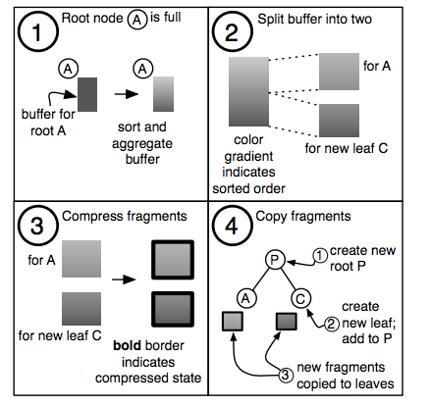
RQ3: Potential fault-tolerant mechanisms
Related work
Disk-based containers: STXXL^{[1]}, TPIE^{[2]}
Compressed Buffer Trees^{[3]}
lower levels of the tree stored on disk
higher levels stored in compressed memory
compressing sub-trees with high aggregation activity in memory
[1] “STXXL: Standard Template Library for Extra Large Data Sets.” http://stxxl.sourceforge.net/
[2] “TPIE - The Templated Portable I/O Environment.” http://madalgo.au.dk/tpie/
[3] Amur H, Richter W, Andersen D G, et al. Memory-efficient groupby-aggregate using compressed buffer trees. SOCC 2013.

Slide 68
Empirical study – conclusions
Studied 123 OOM errors in Hadoop/Spark applications
Summarized the common OOM root causes
Large buffered/cached data
Abnormal dataflow
Memory-consuming user code
Summarized 11 common fix patterns
Proposed two fault-tolerant mechanisms

Slide 69
2. Mprof: Memory profiler for diagnosing memory problems

Slide 70
Motivation
MapReduce applications frequently suffer from
High memory consumption
Out of memory errors
Current memory profilers
Can figure out what objects are (unnecessarily) kept in memory
Memory usage profilers (e.g., JProfiler, Eclipse MAT)
Memory leak detectors (e.g., Cork, Container profiling)
Cannot figure out where the objects come from
Cannot figure out why the objects become so large

Slide 71
Research problem and challenges
Research problem
How to design a memory profiler for diagnosing memory problems in MapReduce applications
Challenges
Static job info does not directly affect the memory usage
MemUsage(task) = f (data, configurations, user code)
Black-box user code
User code is written arbitrarily, or generated by high-level languages

Slide 72
Approach overview
Approach of Mprof
Build memory usage model
MemUsage (task) = f (data, configurations, user code)
Fit memory usage model using
Dataflow profilers
Framework memory profiler
Use code memory profiler
Perform quantified rules to diagnose memory problems
Rules for user code
Excessive memory usage => user code causes and cause-related data
Rules for dataflow
Cause-related data => data skew and improper configurations

Slide 73
Approach – build memory usage model
MemUsage (task) = f (data, configurations, user code)
MR job: <data, configurations, user code>
Mapping
Task’s memory usage

Slide 74
Goal – design a memory profiler for MR apps
Mprof – secondly diagnoses memory problems
Trace memory problems back to the static <data, confs, user code>
MR job: <data, configurations, user code>
Mapping
Trace back to
Task’s memory usage
High memory usage,
Out of memory errors

Slide 75
Mprof – build memory usage model
Build memory usage model
Memory usage is related to runtime data
Solution: build dataflow model
Memory usage is related to user code
Solution: build user code memory model
Memory usage is relate to buffered/cached data
Solution: build framework memory model
Runtime data = f (input data, configurations)
MemUsage (user code) = f (input data of user code)
MemUsage (framework) = f (buffered/cached data)
MemUsage (task) = MemUsage (framework) + MemUsage (use code)

Slide 76
Mprof – Memory usage model – dataflow model
Input split size
Primitive steps | Input records | Output records

Slide 77
Mprof – Memory usage model – dataflow model
Primitive steps | Input records | Output records

Slide 78
Mprof – Memory usage model – dataflow model
Primitive steps | Input records | Output records

Slide 79
Mprof – Memory usage model – dataflow model
Partition function
Records in AP1 : Records in AP2
Primitive steps | Input records | Output records

Slide 80
Mprof – Memory usage model – user code model
Build user code memory model
模型
Cannot use direct monitoring + regression
MemUsage (user code) = f (input data of user code)
MemUsage(reduce) = a * ReduceInputRecords + b
<k1, list(v)>
<k2, list(v)>
<k3, list(v)>
<k4, list(v)>
<k5, list(v)>

Slide 81
Mprof – Memory usage model – user code model
Observation
User code features
Streaming style: process key/value record one by one
User objects have fixed lifecycles
User objects with different lifecycles are related to different parts of input records

Slide 82
内存用量模型－用户代码对象与输入数据关系
map() 中的用户代码对象
用户代码对象生命周期 ① map-level, ② record-level
用户代码对象与输入数据中的特定区域相关
public class Mapper {
private Object mapLevelBuffer; // ①
public void map(K key, V value) {
Object iResults = process(key, value); // ②
mapLevelBuffer.add(iResults); // Optional
emit(newKey, newValue);
}
}
map()中的对象生命周期
②
record-level
①
map-level
已经处理过的 <k, v> records

Slide 83
内存用量模型－用户代码对象与输入数据关系
reduce() 中的用户代码对象
用户代码对象生命周期 ① reduce-level, ② group-level, ③ record-level
public class Reducer {
private Object reduceLevelbuffer; // ①
public void reduce(K key, Iterable<V> values) {
Object groupLevelBuffer; // ②
while (values.hashNext()) { // process <k,list(v)>
Object iResults = process(key, value); // ③
groupLevelBuffer.add(iResults); // Optional
emit(newKey, newValue);
}
}
}
reduce()中的对象生命周期
③
record-level
group-level
②
①
reduce-level
<k1, list(v)>
<k2, list(v)>
<k3, list(v)>
<k4, list(v)>

Slide 84
内存用量模型－用户代码内存用量模型
用户代码模型建立方法
用户代码对象包含不同生命周期的对象
MemUsage(map) = Size(map-level objs) + Size(record-level objs)
MemUsage(reduce) = Size(reduce-level objs) + Size(group-level objs) + Size(record-level objs)
对于生命周期的对象建立不同函数关系
Size(map-level objs) = f (map input records)
Size(reduce-level objs) = f (records in all the groups)
Size(group-level objs) = g (records in current group)
Size(record-level objs) = h (current record)
怎么得到 f, g, h？

Slide 85
内存用量模型－生命周期敏感的内存用量监控策略
不同对象的内存用量监控策略
根据对象生命周期在特定时间点进行 heap dump
用户代码对象生命周期 ① reduce-level, ② group-level, ③ record-level
监控范围：[G1, Gn)
当每个<k, list(v)> group 的第一个record将要被处理时进行heap dump
<k, list(v)>

Slide 86
内存用量模型－生命周期敏感的内存用量监控策略
不同对象的内存用量监控策略
根据对象生命周期在特定时间点进行 heap dump
用户代码对象生命周期 ① reduce-level, ② group-level, ③ record-level
监控范围：[R1, Rn) in Gn
当Gn中的当前record刚被处理完，下一个record要被处理时进行 heap dump
<k, list(v)>

Slide 87
内存用量模型－生命周期敏感的内存用量监控策略
不同对象的内存用量监控策略
根据对象生命周期在特定时间点进行 heap dump
用户代码对象生命周期 ① reduce-level, ② group-level, ③ record-level
监控范围：[Rn-1, Rn] in Gn
当Rn将要被处理,
及当Rn要被处理完输出时
<k, list(v)>

Slide 88
内存用量模型－用户代码内存模型参数推断
用户代码模型参数推断
使用线性回归得到 f, g, h
反映用户代码的空间复杂度
h
g
f

Slide 89
Mprof – Overview
Memory usage profiling
Observation: task’s memory usage is related to runtime data
Approach: dataflow profiler
Building dataflow model
Reconstruct the dataflow
Dataflow model
runtime data = f (input data, confs)
Input data
runtime data
0
t

Slide 90
Mprof – Overview
Memory usage profiling
Observation: task’s memory usage is also related to user code
Approach: user code memory profiler
Reconstruct memory usage history of user code
Perform correlation analysis, identify memory usage patterns
User code memory model
MemUsage(user code) = f (input data of user code)
0
t

Slide 91
Mprof – Approach
Memory problem diagnosis
Rules for user code
OOM error => root cause in user code & error-related data
Rules for dataflow
Error-related data => skewed data & improper configurations

Slide 92
Mprof – Approach
Memory problem diagnosis
Identify memory-consuming code snippets
Objects’ referenced code

Slide 93
Mprof – Design and implementation
Dataflow profiler aims to reconstruct the dataflow
Build dataflow model
Model: runtime data = f (upstream data, confs)
Observation: dataflow consists of three primitive data dependencies
Approach: modeling the primitive data dependencies
Fit dataflow model with dataflow counters
Enhanced tasks’ logs
Dynamic dataflow monitors

Slide 94
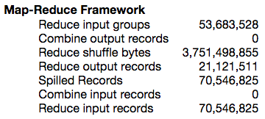
Mprof – Dataflow profiler – fit the dataflow model
Reconstruct the dataflow
Fit dataflow model with dataflow counters
Dynamic dataflow monitors
Enhanced tasks’ logs

Slide 95
Mprof – User code memory profiler
Reconstruct the memory usage of user code
Observation: user objects have different but fixed life cycles
Approach: Life-cycle memory monitoring strategy

Slide 96
Mprof – User code memory profiler – Code template
Objects in map()
Objects have fixed lifecycles (① map-level, ② record-level)
Objects are related to different ranges of input records
public class Mapper {
private Object mapLevelBuffer; // ①
public void map(K key, V value) {
Object iResults = process(key, value); // ②
mapLevelBuffer.add(iResults); // Optional
emit(newKey, newValue);
}
}
Object lifecylces in map()
②
record-level
①
map-level

Slide 97
Mprof – User code memory profiler – Code template
Objects in reduce()
Fixed lifecycles (① reduce-level, ② group-level, ③ record-level)
public class Reducer {
private Object reduceLevelbuffer; // ①
public void reduce(K key, Iterable<V> values) {
Object groupLevelBuffer; // ②
while (values.hashNext()) { // process <k,list(v)>
Object iResults = process(key, value); // ③
groupLevelBuffer.add(iResults); // Optional
emit(newKey, newValue);
}
}
}
Object lifecylces in reduce()
③
record-level
group-level
②
①
reduce-level
<k, list(v)>

Slide 98
Mprof – User code memory profiler
Lifecycle-aware monitoring strategy
Generate heap dump according to the objects’ lifecycles
map(): map-level, record-level
reduce(): reduce-level, group-level, record-level
map()
reduce()

Slide 99
Mprof – User code memory profiler
Lifecycle-aware monitoring strategy
Why use heap dumps? (black-box approach)
Directly monitoring
(contains unreferenced objects)
Monitoring with pre-GC
(buffered data, framework objects)
(time-consuming, CPU overhead)
Real memory usage

Slide 100
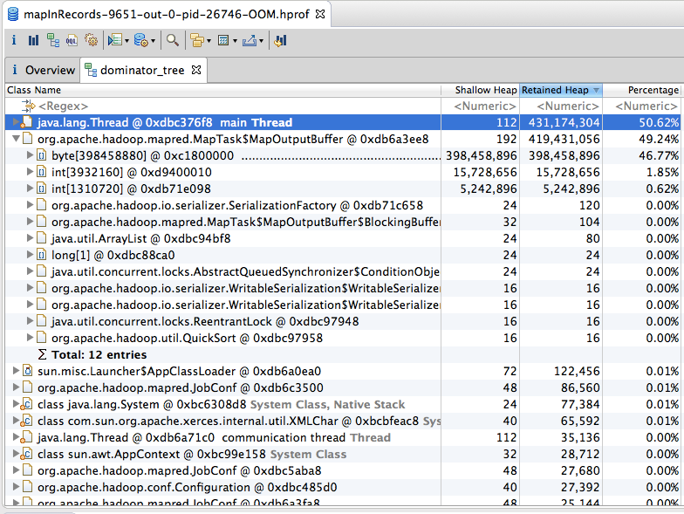
Mprof – User code memory profiler
MemUsage(user code) = Size(user objects in the heap dump)
Why using heap dumps?
Objects in a heap dump
Task’s Heap
dump

Slide 101
Mprof – User code memory profiler
Lifecycle-aware monitoring strategy
Generate heap dumps according to the objects’ lifecycles
Objs at time t in map(): ① map-level + ② record-level
Time points to dump the heap
① map-level objects:
Dump at [R1-Rn)
Current record is processed and the next record is going to be processed

Slide 102
Mprof – User code memory profiler
Lifecycle-aware monitoring strategy
Generate heap dumps according to the objects’ lifecycles
Objs at time t in map(): ① map-level + ② record-level
Time points to dump the heap
Cannot reveal the trend of map-level objects !
① map-level objects:
Dump at [R1-Rn)
If dumping at any time
in [R1-Rn)

Slide 103
Mprof – User code memory profiler
Lifecycle-aware monitoring strategy
Generate heap dumps according to the objects’ lifecycles
Objs at time t in map(): ① map-level + ② record-level
Time points to dump the heap
② record-level objects:
Dump at [Rn-1, Rn]
Rn is going to be processed,
and at the time of OOM

Slide 104
Mprof – User code memory profiler
Lifecycle-aware monitoring strategy
Generate heap dumps according to the objects’ lifecycles
Objs at time t in map(): ① map-level + ② record-level
Time points to dump the heap
② record-level objects:
Dump at [Rn-1, Rn]
Check whether record-level objects are only related to Rn

Slide 105
Mprof – User code memory profiler
Lifecycle-aware monitoring strategy
Generate heap dumps according to the objects’ lifecycles
Objs at time t in reduce(): ① reduce-level + ② group-level + ③ record-level
Time points to dump the heap
① reduce-level objects:
Dump at [G1, Gn)
When the first record in Gi is going to be processed

Slide 106
Mprof – User code memory profiler
Lifecycle-aware monitoring strategy
Generate heap dump according to the objects’ lifecycles
Objs at time t in reduce(): ① reduce-level + ② group-level + ③ record-level
Time points to dump the heap
② group-level objects:
Dump at [R1, Rn) in Gn
When Ri in Gn is going to be processed

Slide 107
Mprof – User code memory profiler
Lifecycle-aware monitoring strategy
Generate heap dump according to the objects’ lifecycles
Objs at time t in reduce(): ① reduce-level + ② group-level + ③ record-level
Time points to dump the heap
③ record-level objects:
Dump at [Rn-1, Rn]
When Rn is going to be processed,
and at the time of OOM

Slide 108
Mprof – Correlation analysis
Identify memory growth patterns
Linear/non-linear growth (using linear/non-linear regression)
Reveal space complexity of user code (e.g., O(n), O(n²), …)
Memory usage patterns
Linear growth of reduce-level objects in [G1, Gn)

Slide 109
Mprof – Correlation analysis
Identify memory growth patterns
Linear/non-linear growth (using linear/non-linear regression)
Reveal space complexity of user code (e.g., O(n), O(n²), …)
Sharp growth (using outlier detection)
Memory usage patterns
Sharp growth of group-level objects in Gn

Slide 110
Mprof – summary
Dataflow profiler (Reconstruct the dataflow)
using quantified dataflow model and dataflow counters
Runtime data = f (upstream data, confs)
User code profiler (Reconstruct memory usage of user code)
Using lifecycle-aware monitoring strategy
MemUsage = f (input records in different ranges)

Slide 111
Mprof – used for diagnosing memory problems
Identify memory-consuming code snippets
Identify root causes in user code and error-related data
Identify the skewed data and improper configurations

Slide 112
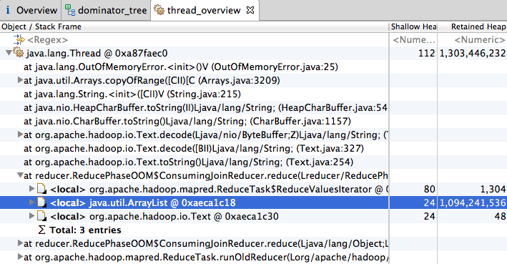
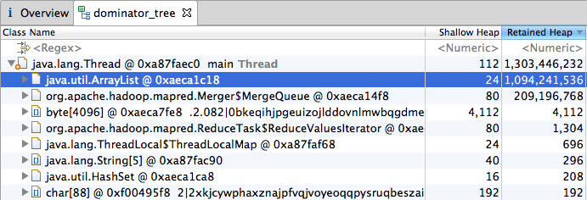
Mprof – identify memory-consuming code snippets

Slide 113
Mprof – identify root causes in user code and error-related data
Rules for user code
RID | Symptoms | Root cause in user code | Error-related data | Next action
1 | Continuous growth in [R1 , Rn) | Large map-level accumulated results | All the input records | Check input split size
2 | Continuous growth in [G1 , Gn) | Large reduce-level accumulated results | All the input records | Check data partition
3 | Continuous growth in group Gn | Large group-level accumulated results | Records in group Gn | Check hotspot key
4 | Sharp growth at Rn | Large record-level intermediate results | Current record Rn | Check large single record
5 | Objects at R1 /G1 are huge | Large external data | The external data | Output Size(Objects at R1 /G1 )

Slide 114
Mprof – identify the skewed data and improper configurations
Rules for dataflow
RID | Symptoms | Root cause in user code | Error-related data | Next action
1 | Continuous growth in [R1 , Rn) | Large map-level accumulated results | All the input records | Check input split size
2 | Continuous growth in [G1 , Gn) | Large reduce-level accumulated results | All the input records | Check data partition
3 | Continuous growth in group Gn | Large group-level accumulated results | Records in group Gn | Check hotspot key
4 | Sharp growth at Rn | Large record-level intermediate results | Current record Rn | Check large single record
5 | Objects at R1 /G1 are huge | Large external data | The external data | Output Size(Objects at R1 /G1 )

Slide 115
Mprof – identify the skewed data and improper configurations
Rules for dataflow
RID | Symptoms | Root cause in user code | Improper configurations
6-1 | Rule 2 is matched & data partition is balanced | Improper data partition | Small reduce number
6-2 | Rule 2 is matched & data partition is unbalanced | Improper data partition | Unbalanced partition function
7 | Sharp growth in Gn & Gn has much more records | Hotspot key | The key design is bad
8 | Rule 4 is matched & Rn is much larger than the other records | Large single record | None
9-1 | Fixed buffer exists & map() is nearly finished | Large framework buffer | Large fixed buffer
9-2 | Virtual buffer is full & combine()/reduce() is nearly finished | Large framework buffer | Large virtual buffer

Slide 116
Mprof – identify the skewed data and improper configurations
Rules for dataflow
Skew modeling
A point beyond an inner fence on either side is considered a mild outlier. A point beyond an outer fence is considered an extreme outlier.

Slide 117
Mprof – Evaluation
Diagnosis results
Overhead
Case studies

Slide 118
Mprof – Evaluation – diagnosis results & overhead
Identify the root cause of 15 cases
Identify the partial root causes of 5 cases
Phase | Job name | Rules | Identified causes | Root causes? | Verification (fixe methods) | Overhead
Map | NLPLemmatizer | 4,8 | Large iResults, Large single record | ✓ | Split Rn into small records | 135s
 | InMemWordCount | 1 | Large map-level accResults | ✓ | ↓ Input split size, FixMethod(a) | 121s
 | MapSideAggregation | 1 | Large map-level accResults | ☑ | ↓ Input split size | 95s
 | PigDistinctCount | 3 | Large group-level accResults | ☑ | FixMethod (a) | 82s
 | CDHJob | 9-1 | Large fixed framework buffer | ✓ | ↓ map buffer size | 113s
 | MahoutBayes | 5 | Large external data | ✓ | ↓ external data (trained model) | 87s
 | MahoutConvertText | 5 | Large external data | ✓ (+) | ↓ external data (training data) | 91s
 | HashJoin | 5 | Large external data | ✓ (+) | ↓ external data (the first table) | 114s
Shuffle | ShuffleInMemory | 6-1 | Improper data partition | ✓ (+) | ↑ partition number | 110s
 | WordCount-like | 9-2 | Large virtual framework buffer | ✓ | ↓ shuffle buffer | 129s
 | PigJoin | 9-2 | Large virtual framework buffer | ✓ | ↓ shuffle buffer | 123s
 | NestedDISTINCT | 3 | Large group-level accResults | ☑ (+) | FixMethod (b) | 179s
 | PigOrderLimit | 3, 7 | Large group-level accResults, Hot key | ☑ | FixMethod (b) | 194s
Reduce | GraphPartitioner | 3 | Large group-level accResults | ✓ | FixMethod (c) | 205s
 | FindFrequentValues | 3 | Large group-level accResults | ✓ | FixMethod (b) | 138s
 | ReduceJoin | 3, 7 | Large group-level accResults, Hot key | ✓ | FixMethod (a) | 136s
 | PositionalIndexer | 3, 7 | Large group-level accResults, Hot key | ✓ | FixMethod (a) | 144s
 | BuildInvertedIndex | 3, 7 | Large group-level accResults, Hot key | ✓ | FixMethod (c) | 231s
 | CooccurMatrix | 3, 7 | Large group-level accResults, Hot key | ✓ | FixMethod (c) | 155s
 | JoinLargeGroups | 3, 7 | Large group-level accResults, Hot key | ☑ (+) | Shrink the <k, list(v)> group | 187s

Slide 119
Mprof – Evaluation – Case study 1
Guess the root causes
Large accumulated results in slem
Large record-level intermediate results generated by lemmatize(value)
1 public class Mapper {
2 StanfordLemmatizer slem = new StanfordLemmatizer();
3 public void map(Long key, Text value) {
4 String line = value.toString();
5 for(String word: slem.lemmatize(line)) => 282MB
6 emit(word, 1);
7 }
8 }
NLPLemmatizer

Slide 120
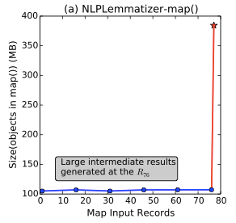
Mprof – Evaluation – Case study 1
Guess the root causes
Large accumulated results in slem
Large record-level intermediate results generated by lemmatize(value)
Symptoms
No growth in [R1, R76) => No large accumulated results in slem
Sharp growth at R76 => Large intermediate results in lemmatize() (Rule 4)
Root causes
lemmatize() allocates large temporary data structures
5 times larger than the line
1 public class Mapper {
2 StanfordLemmatizer slem = new StanfordLemmatizer();
3 public void map(Long key, Text value) {
4 String line = value.toString();
5 for(String word: slem.lemmatize(line)) => 282MB
6 emit(word, 1);
7 }
8 }
NLPLemmatizer
R1
R76

Slide 121
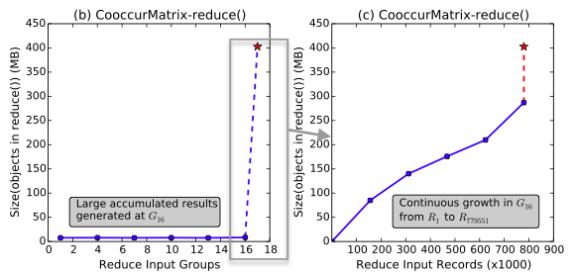
Mprof – Evaluation – Case study 2
Guess the root causes
Do not know the code semantics of plus()
Symptoms
No continuous growth in [G1, G16) => no reduce-level accumulated results
Linear growth in G16 => Large group-level accumulated results in wordMap
Root causes
wordMap() accumulated too many words in group-level buffer wordMap
1 public class Reducer {
2 void reduce(Text key, Iterable<OHMap> values) {
3 Iterator<OHMap> iter = values.iterator();
4 OHMap wordMap = new OHMap();
5 while (iter.hasNext()) { // for(V value: values)
6 wordMap.plus(iter.next()); => wordMap:OHMap(372MB)
7 }
8 emit(key, wordMap);
9 }
10 }
CooccurMatrix

Slide 122
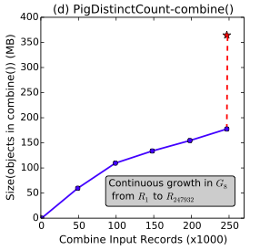
Mprof – Evaluation – Case study 3
Guess the root causes
No explicit user code (i.e., map(), reduce(), combine())
Symptoms
Continuous growth in G8 => no reduce-level accumulated results
G8 has much more records => hot key (pagerank 3 has too many distinct urls)
Pig.data.InternalDistinctBag, PigCombine.procesOnePackageOutput()
Root causes
DISTINCT operator allocates a data structure to accumulate all the input records to sort and deduplicate them
1 pTable = LOAD “tableA” as (pagerank,pageurl,aveduration);
2 rankTable = GROUP pTable BY pagerank;
3 urlTable = FOREACH rankTable {
4 urls = DISTINCT urlTable.pageurl;
5 GENERATE group, COUNT(urls), SUM(pTable.aveduration);
6 };
7 STORE urlTable into "/output/newTable”;
SQL-like Pig script

Slide 123
Mprof – Limitation and discussion
Cannot identify the code semantics
Used for Spark
Insights
Pig-operator tree
Program analysis

Slide 124
Mprof – Conclusions
Memory usage profiling
Figure out the correlation between memory usage and static infos
Memory problems diagnosis
Rules to identify the root causes
Used for Spark (thread, pipeline)
Insights
Pig-operator tree
Program analysis

Slide 125
Thanks! Q&A

